Slide 1
Benchmarking of Commercial Cells
IISc- Phase 3

Slide 2
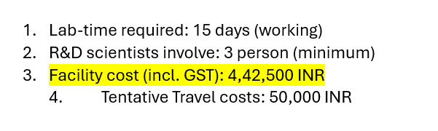
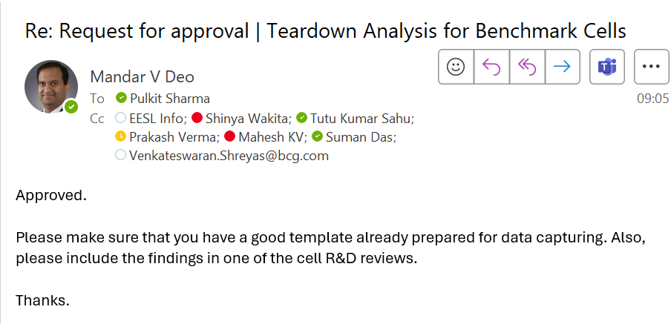
Approvals & timelines
Management Approvals
Timeline of starting IISc activity
Tentatively: 16-06-2025
>> Prantij Cells dispatch issues
>> PR/PO generation
Expected time of finish IISc: 04-07-2025

Slide 3
Images of the overall cell:
Sr. No. | Cells | Overall cell | Top view | Bottom view
1 | BAK 5.5_21700
2 | 4680 Gen2
3 | Blivex 32700
4 | CBAK 32140
5 | EVE 5.0 _21700
6 | Molicell 4.2_21700
7 | RIN 5.8_21700
8 | SVOLT 116 Ah

Slide 4
Cells to be teardown & cell history
Sr. No. | Cell brand | Rated capacity | Date/ month of manufacuring | Cell purchased date | Cell Initial charge/discharge cycle available with testing team | OCV of cell as received from testing team | Cell condition (fresh/cycled cell) | If cycled, cycled conditions
1 | BAK 5.5_21700
2 | 4680 Gen2
3 | Blivex 32700
4 | CBAK 32140
5 | EVE 5.0 _21700
6 | Molicell 4.2_21700
7 | RIN 5.8_21700
8 | SVOLT 116 Ah

Slide 5
Cylindrical cell report

Slide 6
Cylindrical Cells: Physical Parameters
 |  | BAK 5.5_21700 | 4680 Gen2 | Blivex 32700 | CBAK 32140 | EVE 5.0_21700 | Moilicell 4.2 21700 | RIN 5.8 _21700
Cell type
Cell weight, without sleeve (gm)
Cell Dia | Top
 | bottom
Cell length | Total
 | Up to Cap

Slide 7
Cathode: Overall comparison
 |  | BAK 5.5_21700 | 4680 Gen2 | Blivex 32700 | CBAK 32140 | EVE 5.0_21700 | Moilicell 4.2 21700 | RIN 5.8 _21700
Material | Cathode material
 | Composition
Foil | Length of Al foil (coating + uncoating) (mm)
 | Width of Al Foil (mm)
Thickness | Bare Al foil (um)
 | A-side (w/o Al)
 | B-side (w/o Al)
 | Total
Areal density (mg/cm2) | Bare Al foil
 | A-Side (w/o Al)
 | B-Side (w/o Al)
 | Total_A+B_(w/o Al)

Slide 8
Anode: Overall comparison
 |  | BAK 5.5_21700 | 4680 Gen2 | Blivex 32700 | CBAK 32140 | EVE 5.0_21700 | Moilicell 4.2 21700 | RIN 5.8_21700
Material | Anode material
Foil | Length of Cu foil (coating + uncoating) (mm)
 | Width of Cu Foil (mm)
Thickness | Bare Cu foil (um)
 | A-side (w/o Cu)
 | B-side (w/o Cu)
 | Total
Loading (mg/cm2) | Bare Cu foil
 | A-Side (w/o Cu)
 | B-Side (w/o Cu)
 | Total_A+B_(w/o Cu)

Slide 9
Separator: Overall comparison
 |  | BAK 5.5_21700 | 4680 Gen2 | Blivex 32700 | CBAK 32140 | EVE 5.0_21700 | Moilicell 4.2 21700 | RIN 5.8_21700
Material | From SEM surface morphology | To be checked @ EESL facility once ready
No of separators in cell | Design
Separator-1 Length | Design
Separator-2 Length | Design
Separator Width | Design
Separator Thickness | Design
Base film thickness | From SEM cross-section | To be checked @ EESL facility once ready
Is both separators morphology identical | Visual inspection
Is separator Coated both sides/single side | Visual/SEM morphology
Coating thickness on cathode side of separator (Probable) | Design & visual inspection
Coating thickness on Anode side of separator (Probable) | Design & visual inspection
Coating material on cathode side | From SEM-EDX | To be checked @ EESL facility once ready
Coating material on Anode side | From SEM-EDX | To be checked @ EESL facility once ready

Slide 10
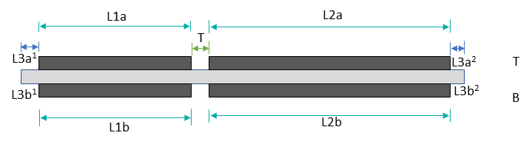
Cathode Electrode Design: Overall comparison
 | Length | Side | L3a1/L3b1 | L1a/L1b | T | L2a/L2b | L3a2/L3b2
BAK 5.5_21700 |  | T
 |  | B
4680 Gen2 |  | T
 |  | B
Blivex 32700 |  | T
 |  | B
CBAK 32140 |  | T
 |  | B
EVE 5.0_21700 |  | T
 |  | B
Moilicell 4.2 21700 |  | T
 |  | B
RIN 5.8_21700 |  | T
 |  | B
Cathode

Slide 11
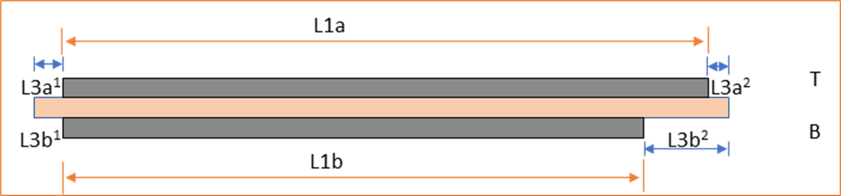
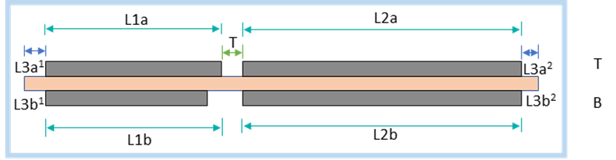
Anode Electrode Design: Overall comparison
 | Length | Side | L3a1/L3b1 | L1a/L1b | T | L2a/L2b | L3a2/L3b2
BAK 5.5_21700 |  | T
 |  | B
4680 Gen2 |  | T
 |  | B
Blivex 32700 |  | T
 |  | B
CBAK 32140 |  | T
 |  | B
EVE 5.0 _21700 |  | T
 |  | B
Molicell 4.2_21700 |  | T
 |  | B
RIN 5.8_21700 |  | T
 |  | B
Anode

Slide 12
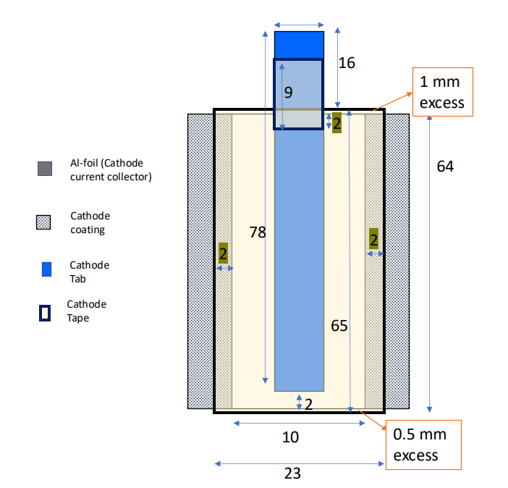
Cathode Tab Design: Overall comparison
BAK 5.5_ 21700 | 4680 Gen2 | Blivex 32700 | CBAK 32140 | EVE 5.0_21700 | Moilicell 4.2 21700 | RIN 5.8_21700
 | TABLESS
Sample

Slide 13
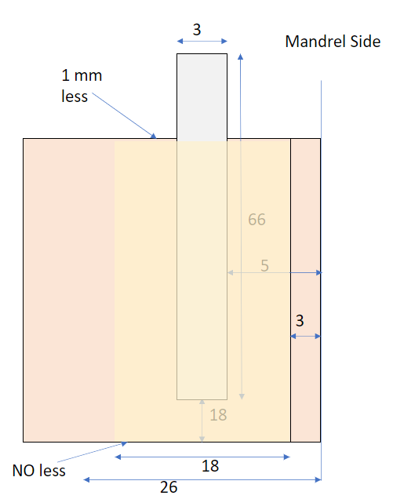
Anode Tab Design: Overall comparison
BAK 5.5_ 21700 | 4680 Gen2 | Blivex 32700 | CBAK 32140 | EVE 5.0_21700 | Moilicell 4.2 21700 | RIN 5.8_21700
 | TABLESS
Sample

Slide 14
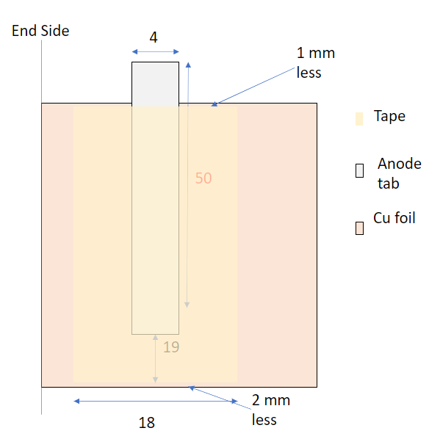
Anode Tab Design: Overall comparison
BAK 5.5_ 21700 | 4680 Gen2 | Blivex 32700 | CBAK 32140 | EVE 5.0_21700 | Moilicell 4.2 21700 | RIN 5.8_21700
Sample
(Mandrel Side)
Sample
(End Side)

Slide 15
Jelly Roll Design: Overall comparison
Overall Cell | BAK 5.5_ 21700 | 4680 Gen2 | Blivex 32700 | CBAK 32140 | EVE 5.0_21700 | Moilicell 4.2 21700 | RIN 5.8_21700
Jelly roll dia (at middle)
Jelly roll dia (at cathdoe side)
Jelly roll dia (Anode side)
Jelly roll length
Length of tape attached (with separator/Cu-foil)
Width of tape attached (with separator/Cu-foil)
Mandrel inner dia, mm
JR Volume( ml)
Cell Volume (ml)
% of free space

Slide 16
Parts analysis of cylindrical cells

Slide 17
Prismatic cell Report

Slide 18
Physical parameters
Parameters | Value | Unit
Cell makes | SVOLT
Nominal voltage |  | V
Cell type | Prismatic
Cell voltage, OCV |  | V
SOC of the cell as received |  | %
Rated capacity | 116 Ah @ XXX C-rate | Ah
Cell weight |  | kg
Cell dimension (length * height * width) |  | mm
Positive terminal dimensions (length* height * width) |  | mm
Negative terminal dimensions (length* height * width) |  | mm
Positive terminal height from cell base (Height without tab) |  | mm
Negative terminal height from cell base (Height without tab) |  | mm

Slide 19
Jelly roll parameters
Parameters | Values | Units
No. of jelly roll
Jelly roll dimension (length x height x width) |  | mm
Type of jelly roll
Tape combining jelly rolls, colour, width thickness (wide tape)
Small tapes dimensions
Tape for fixing separator at the end |  | mm
Extra separator (outer side) from cathode |  | mm
Extra separator (outer side) from anode |  | mm
Curvature of the stack |  | mm
Parameters | Value | Units
Jelly roll tab welding | Ultrasonic
Jelly roll to connecting piece welding | Ultrasonic
Cathode connecting piece to cap welding | Laser
Anode connecting piece to cap welding | Laser
Cap to can peripheral welding with can | Laser
Electrolyte plate to cap welding | Laser
Mylar
Thickness of the mylar wrapping sheet |  | mm
Thickness of the bottom mylar sheet |  | mm
Hot pressing on mylar edge (Yes/No)
Dimensions of the Mylar
Bottom plate
Pattern of holes for electrolyte circulation

Slide 20
Cathode & Anode electrode details
Parameter | Value |  | Units
 | Cathode | Anode
Al-current collector average thickness |  |  | µm
Number of electrodes
Length of coated cathode |  |  | mm
Width of cathode coating |  |  | mm
Total thickness of the cathode |  |  | µm
A side / B-side CAM loading |  |  | mg/cm²
No. of tabs (welded)
Width of the tab |  |  | mm
Length of the tab |  |  | mm
Welding type

Slide 21
Separator details
Parameters | Values | Units
No. of Separators
Separator 1 dimensions (L×W×T) |  | mm
Thickness |  | mm
Appearance

Slide 22
Cut open images

Slide 23
Parts analysis of prismatic cell

